Slide 1
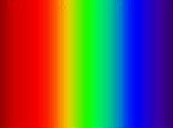
THE
ELECTROMAGNETIC
SPECTRUM
JParkinson
©
Notes:
Click to start
Automatic transition to slides 2 and 3

Slide 2
ALL ELECTROMAGNETIC WAVES
TRAVEL AT THE
SPEED OF LIGHT
300 000 000 m / s
c = 300 000 000 m/s
Notes:
All electromagnetic waves travel the speed of ligh
300 000 000 m/s
Automatic transition to slide 3

Slide 3
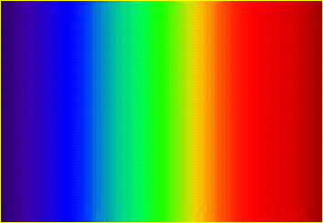
The Electromagnetic Spectrum
WAVELENGTH
λ
SHORT
WAVELENGTH
LONG
WAVELENGTH
OUR EYES CAN ONLY SEE A SMALL FRACTION IN THE MIDDLE OF THE WHOLE SPECTRUM
Which colour has the longer wavelength, red light or blue light?
Which colour has the greater frequency, red light or blue light?

Slide 4
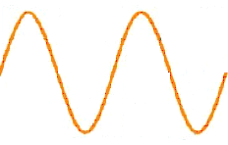
THE FREQUENCY OF A WAVE IS THE NUMBER OF WAVES EMITTED PER SECOND
Frequency, f, is measured in HERTZ
Hz

Slide 5
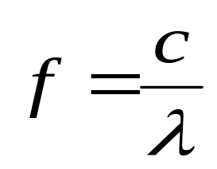
The speed at which the crests move along, c, the frequency of the waves and their wavelength are related by the formula:
velocity = frequency times wavelength
c = f λ
c
Hence
=
f x λ

Slide 6


The Electromagnetic Spectrum
FREQUENCY
INCREASING
WAVELENGTH
INCREASING
ELECTROMAGNETIC RADIATION COMES IN BURST CALLED PHOTONS
HIGH FREQUENCY RADIATIONS TEND TO BE MORE PENETRATING

Slide 7
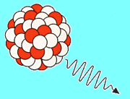

Gamma Ray photon; wavelength 10⁻¹¹ – 10⁻¹³ metres, i.e. about a million millionth of a metre
APPLICATIONS:
sterilizing medical equipment in hospitals
pasteurizing certain foods to prolong shelf life
treatment of cancer
gauge the thickness of metal in steel mills
radiography – patient ingests radioactive source, whereabouts in the body is then located with a gamma camera

Slide 8
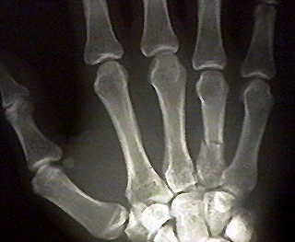
X Ray photon; wavelength 10⁻⁹ – 10⁻¹¹ metres, i.e. about a billionth of a metre… about the size of an atom
APPLICATIONS:
radiography
treatment of cancer cells
airport security checks
studying atomic and molecular structure ….. X-Ray crystallography
JParkinson
©

Slide 9



Ultra Violet light wavelength 10⁻⁷ – 10⁻⁸ metres, i.e. about a ten millionth of a metre… the size of a virus
APPLICATIONS:
criminology…. some stains [e.g. blood] fluoresce under uv light
security marking
detection and destruction of bacteria
phototherapy treatment of skin complaints, e.g. psoriasis
JParkinson
©

Slide 10


wavelength about
0.5 micrometres [μm]
or half a millionth of a metre
VISIBLE LIGHT
Protazoa size
0.4 μm
0.7 μm

Slide 11


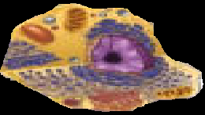
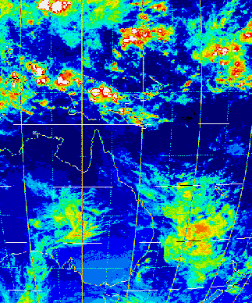


INFRA RED
wavelength about
1mm to 1μm
pinhead to cell
APPLICATIONS:
night-time surveillance
medical: CO₂ laser surgery & thermal imaging
weather forecasting
remote controls
heat seeking missiles

Slide 12
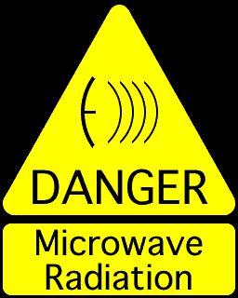
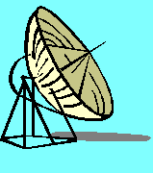
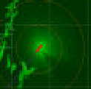
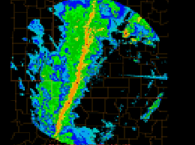

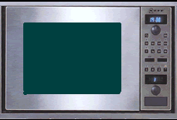
microwaves
& radar
Wavelength:
a few centimetres
APPLICATIONS:
radar inc. weather forecasting
cooking
telecommunications inc. mobile phones

Slide 13




TV & RADIO
APPLICATIONS & WAVELENGTHS:
Ultra High Frequency - UHF for TELEVISION …… about 10 cm
Very High Frequency - VHF for FM RADIO ……. about 1 metre
Short Wave – SW … AM Radio …… 10m & 50m bands
Medium Wave – MW … AM Radio …… 200 to 600m
Long Wave – LW … AM Radio …… 1000 to 2000m

